Slide 1
NON-RENEWABLE ENERGY
Giuseppe Larocca
Ferdinando Calì
Jorge Villalobos
Andrei Alin Burtea
Fatma Sude Genc

Slide 2
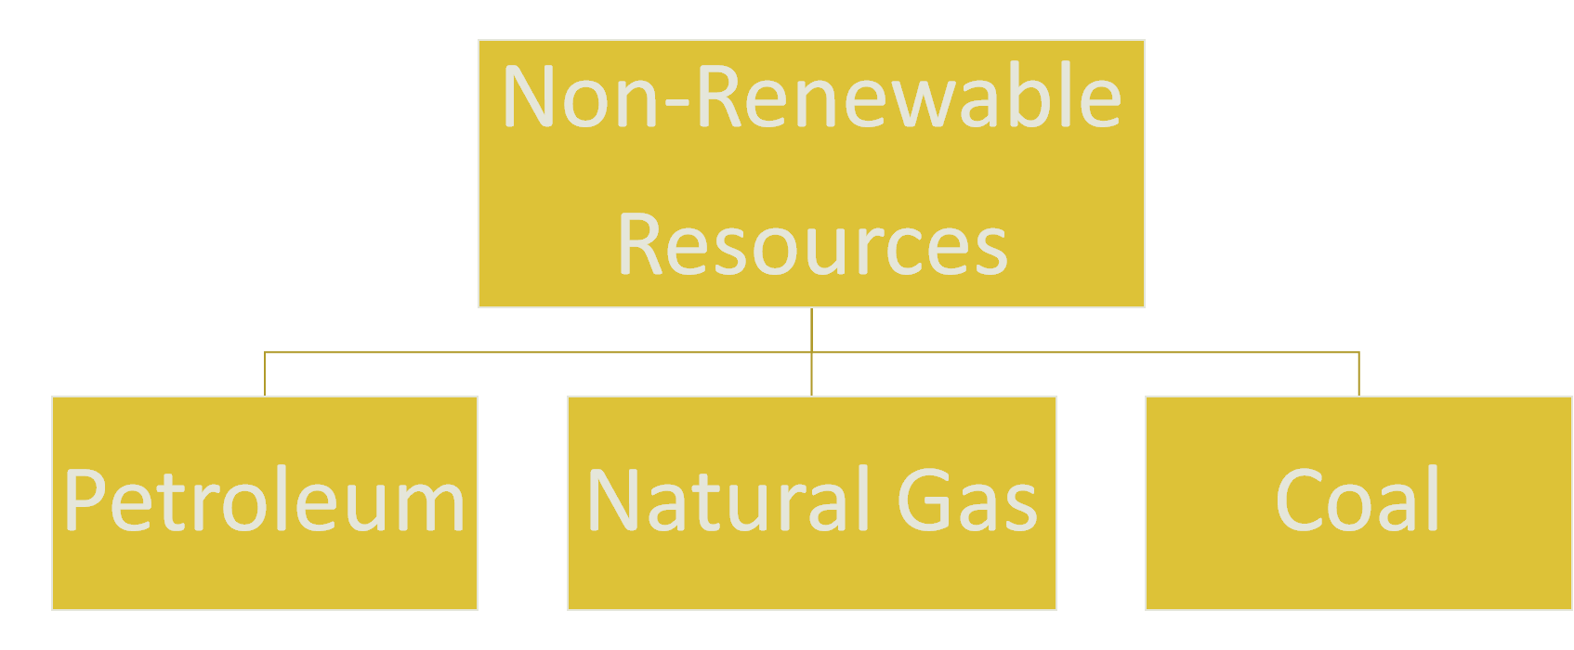
What Are The Fossil Fuels?

Slide 3
What Is The Fossil Fuel?
Fossil fuels are non-renewable energy resources; these are coal, oil and natural gas. They were formed from the remains of living organisms millions of years ago.
Some of the usage areas: transportation, heating, electricity generation etc.
Petroleum products: from drilling-extraction, from refineries, from petrochemical plants, from ship, car, pipeline.

Slide 5
How They Formed?
Fossil fuels are formed over millions of years from the fossils, or remains, of dead animals and plants that were buried under dirt and rock.
Heat from inside the earth and pressure from dirt and rock changes these fossils into oil, natural gas and coal.

Slide 6
Advantages Of Fossil Fuels
Supplies are abundant so the cost is cheap.
Can produce large amount of energy.
Oil can be transported through the use of pipes, allowing it to be transported relatively easily.

Slide 7
Disanvanteges Of Fossil Fuel
Not sustainable. Fossil fuels will run out.
One of the main disadvantages of fossil fuels is the fact that they are burned, they produce carbon dioxide.
It causes global warming.

Slide 8
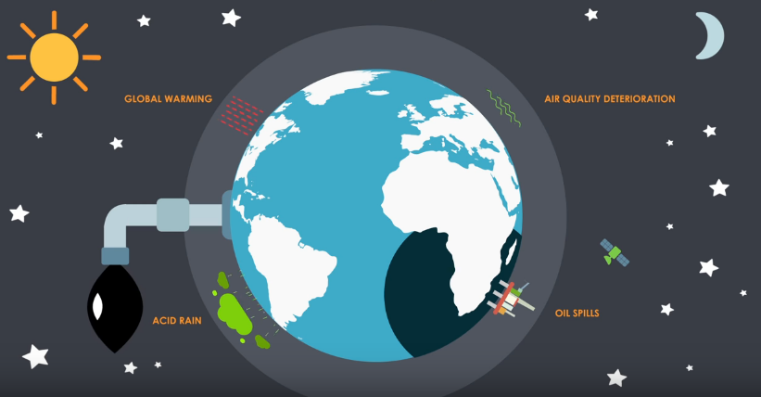
If We Continue To Use Fossil Fuels

Slide 9
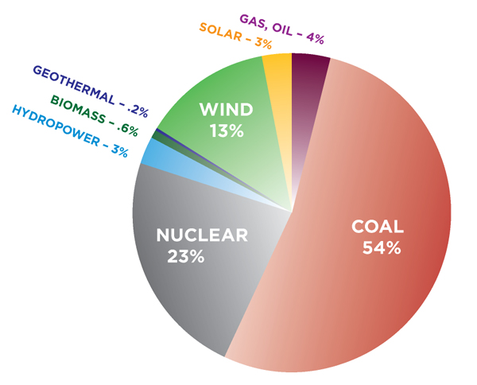
The Percentage Of Using Resources

Slide 10
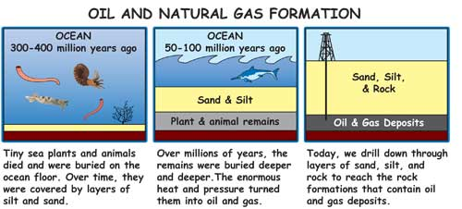
Formation Of Oil & Natural Gas

Slide 11
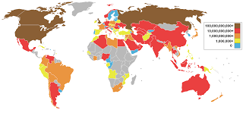
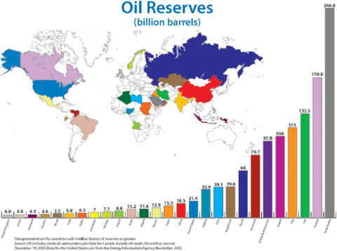

Slide 12
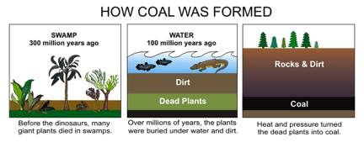
Formation Of Coal

Slide 13
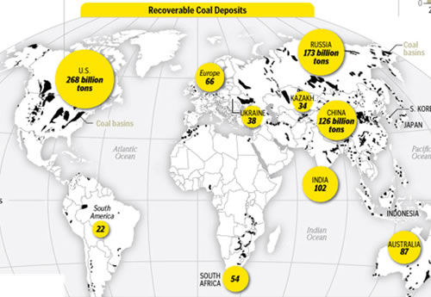

Slide 14
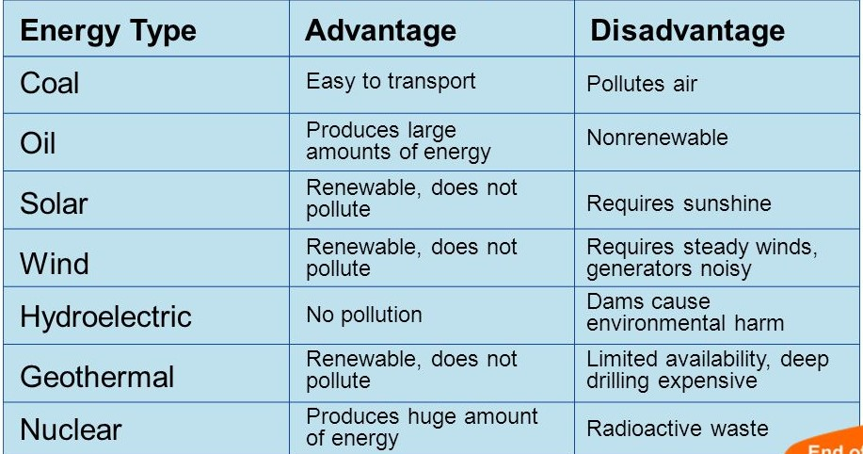
Comparing Advantages & Disadvantages

Slide 15
How We Use Efficient?
Improving the energy efficiency of buildings, vehicles, industrial processes, appliances and equipment is the most immediate and cost effective way to reduce energy use.
Planning communities where people can safely and conveniently use public transit, walk, or bike, instead of using private vehicles.
There are several alternative resources that can supply clean, renewable energy to replace fossil fuels, including water, biomass, wind, geothermal, and solar energy.

Slide 16
THANK YOU FOR YOUR ATTENTION

