Slide 1
EFFICIENT USAGE OF NATURAL RESOURCES

Slide 2
WHY DO WE NEED AN EFFICIENT USAGE OF NATURAL RESOURCES?
The growth of the economy and the increase of the population in the world mean that the Earth's natural resources are running out at high speed
Our society depends on metals, minerals, fuels, water, wood, fertile soil and clean air. However, we have been depleting these limited resources at a much faster rate than the one that allows their recovery, and if we do not change the way of acting there will be great shortages.

Slide 3
Our society depends on metals, minerals, fuels, water, wood, fertile soil and clean air. However, we have been depleting these limited resources at a much faster rate than the one that allows their recovery, and if we do not change the way of acting there will be great shortages.

Slide 4
That is why it is necessary to "use resources efficiently", that is, to generate more value by using less materials and consuming in a different way. This will reduce the risk of scarcity, and the environmental impacts will remain within the natural limits of our planet.

Slide 5
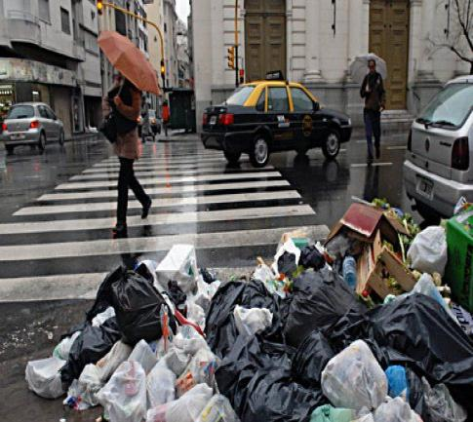
THE MAIN PROBLEMS OF WASTE
The production of waste is growing all over the world. The generation of garbage brings the following environmental impacts:

Slide 6
The consumption of energy and materials used to make packaging and products that we later discard
Water, air and ground pollution.
All this has negative effects on human health and the environment

Slide 7
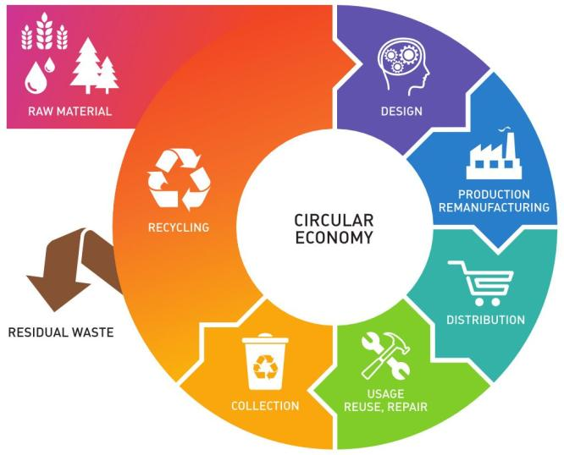

Slide 8
Energy

Slide 9
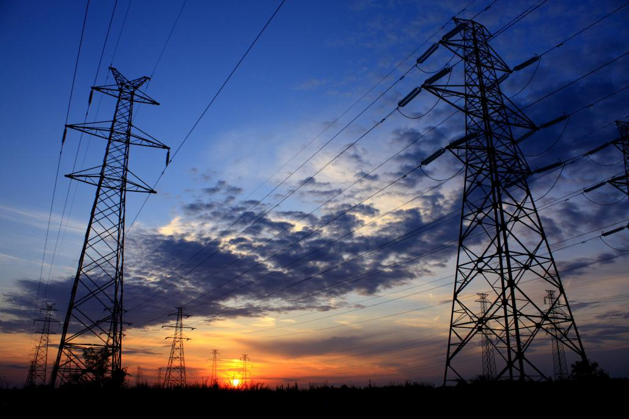
Between 1990 and 2010, the number of people with access to electricity has increased by 1.7 billion

Slide 10
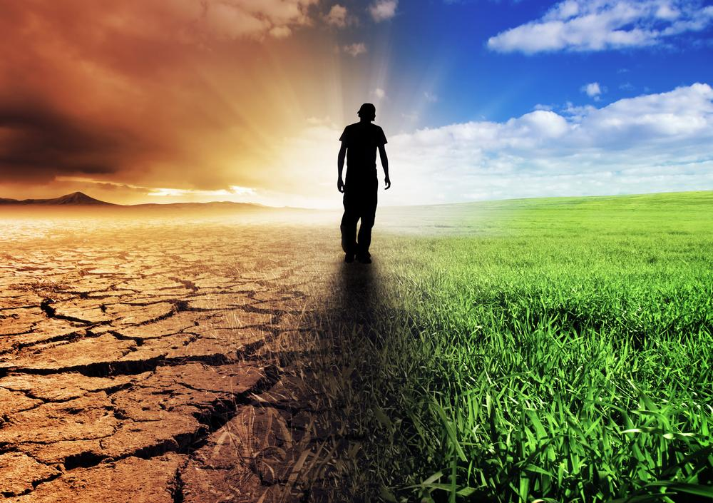
ENERGY - KEY FACTS
One in five people still lacks access to modern electricity
3 billion people rely on wood, coal, charcoal or animal waste for cooking and heating
Energy is the dominant contributor to climate change, accounting for around 60 per cent of total global greenhouse gas emission
Reducing the carbon intensity of energy is a key objective in long-term climate goals.

Slide 11
The main global initiative on the sustainable use of energy resources is part of the Sustainable Development Goals of the United Nations

Slide 12
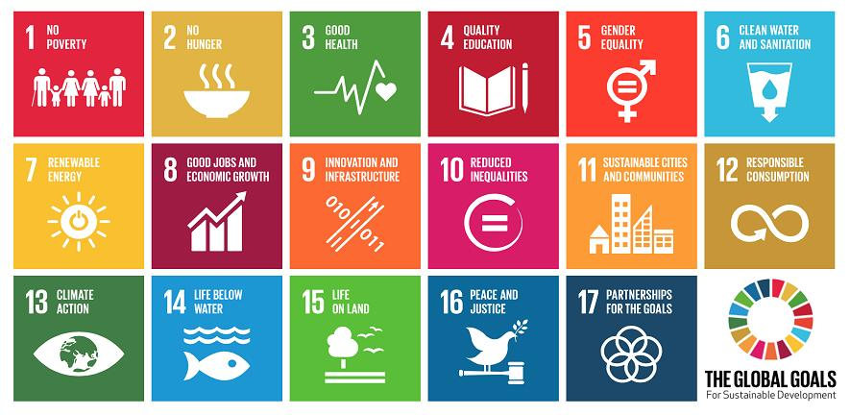

Slide 13
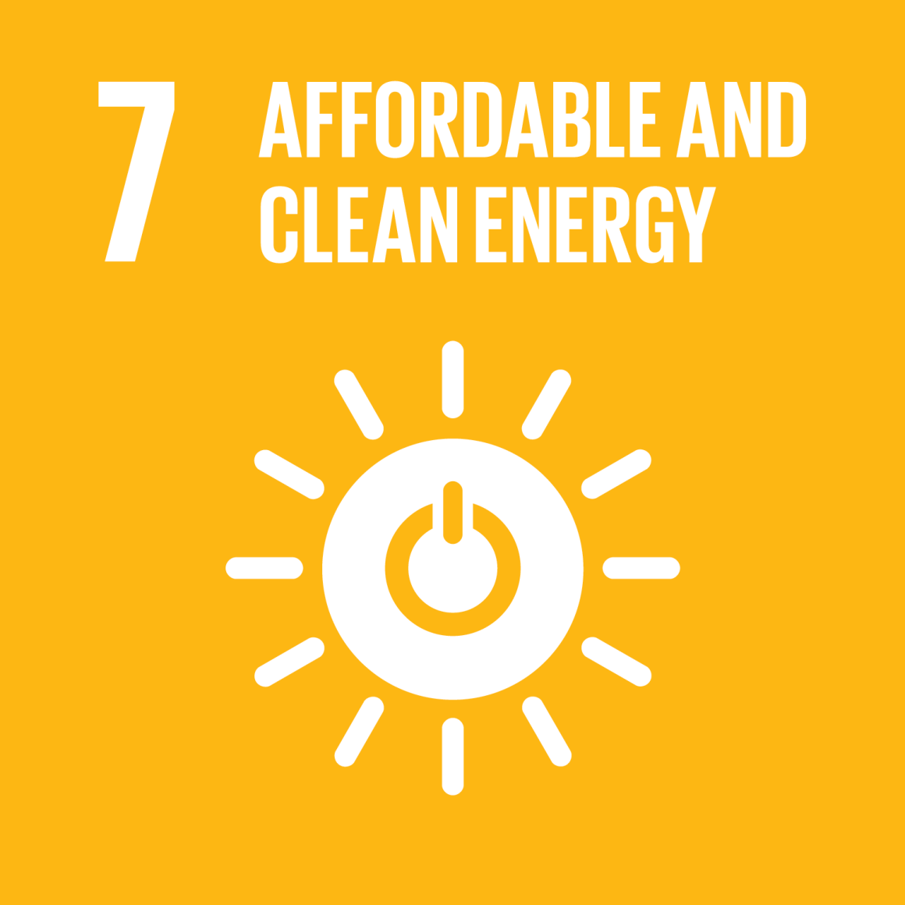

Slide 14
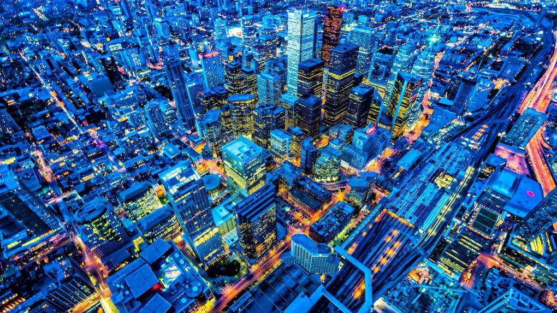
TARGETS:
By 2030, ensure universal access to affordable, reliable and modern energy services.
By 2030, increase substantially the share of renewable energy in the global energy mix .
By 2030, double the global rate of improvement in energy efficiency.
By 2030, enhance international cooperation to facilitate access to clean energy research and technology, including renewable energy, energy efficiency and advanced and cleaner fossil-fuel technology, and promote investment in energy infrastructure and clean energy technology.

Slide 15
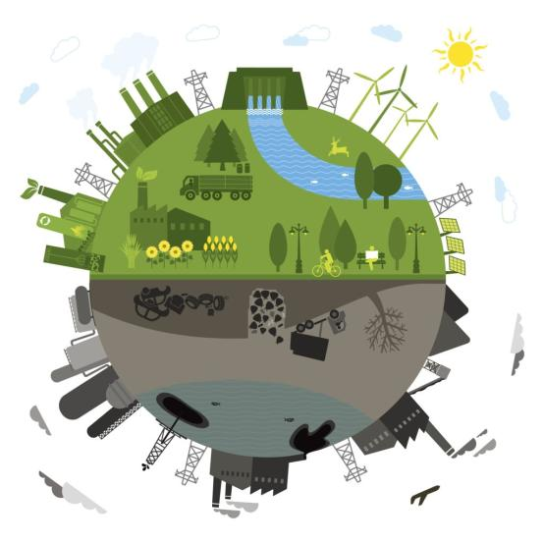
No more non-renewable energies should be used because they pollute a lot and have a close limit. Therefore, from our homes we would have to start encouraging the use of new sources of energy, for example by promoting the installation of solar panels in our urbanization.

Slide 16
Have a look at just a few of the many things you can do to make an impact!
Save electricity by plugging appliances into a power strip and turning them off completely when not in use, including your computer.
Stop paper bank statements and pay your bills online or via mobile. No paper, no need for forest destruction.
Don’t print. See something online you need to remember? Jot it down in a notebook or better yet a digital post-it note and spare the paper.
Turn off the lights. Your TV or computer screen provides a cosy glow, so turn off other lights if you don’t need them.

Slide 17
Do a bit of online research and buy only from companies that you know have sustainable practices and don’t harm the environment.
Air dry. Let your hair and clothes dry naturally instead of running a machine. If you do wash your clothes, make sure the load is full.
Take short showers. Bathtubs require gallons more water than a 5-10 minute shower.
Eat less meat, poultry, and fish. More resources are used to provide meat than plants

Slide 18
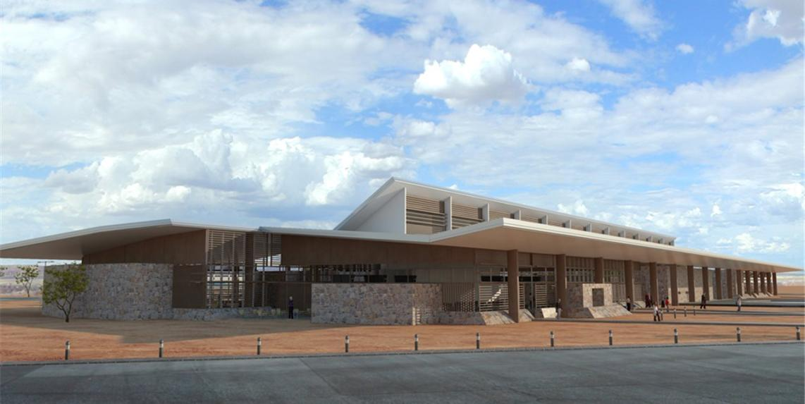
A good example:
The ecuadorian archipelago of the Galapagos Islands, has the first ecological airport in the world. It works through solar energy, the reuse of water and the use of wind

Slide 19
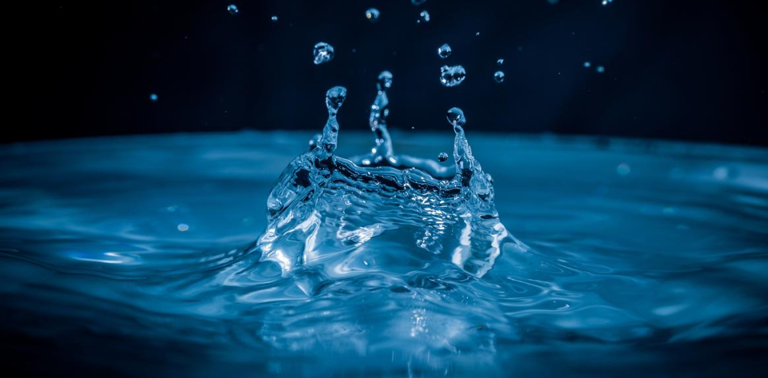
Actually Water Consumption

Slide 20
What is current water consumption?
Domestic consumption of water per inhabitant is understood as the amount of water a person has for their daily consumption, cleaning, irrigation, etc.

Slide 21
What is the water consumption per person?
The optimal access, finally, is the consumption of an average amount of 100 liters per person of water supplied continuously through several faucets in which all the consumption and hygiene needs are met.

Slide 22
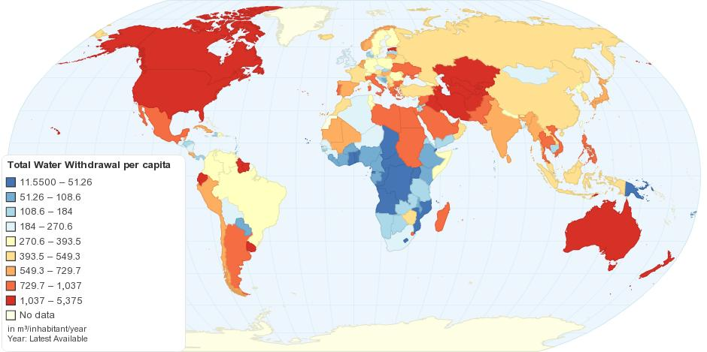
Total Water Withdrawal per capita

Slide 23
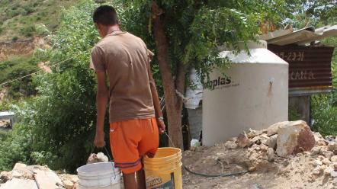
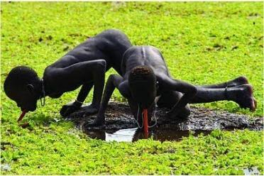
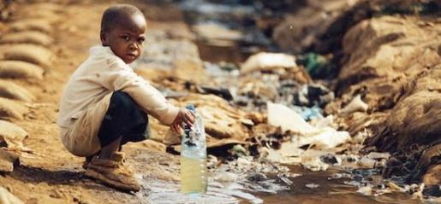
Consequences of wasting water
There are some situations in which the lack of water reaches inhumane limits

Slide 24
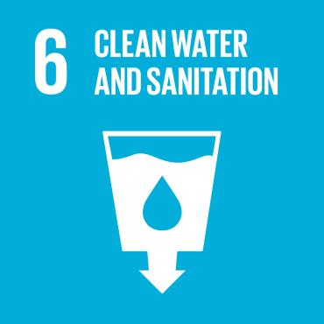
The main global initiative in defense of water resources is part of the Sustainable Development Goals of the United Nations

Slide 25
.

Slide 26
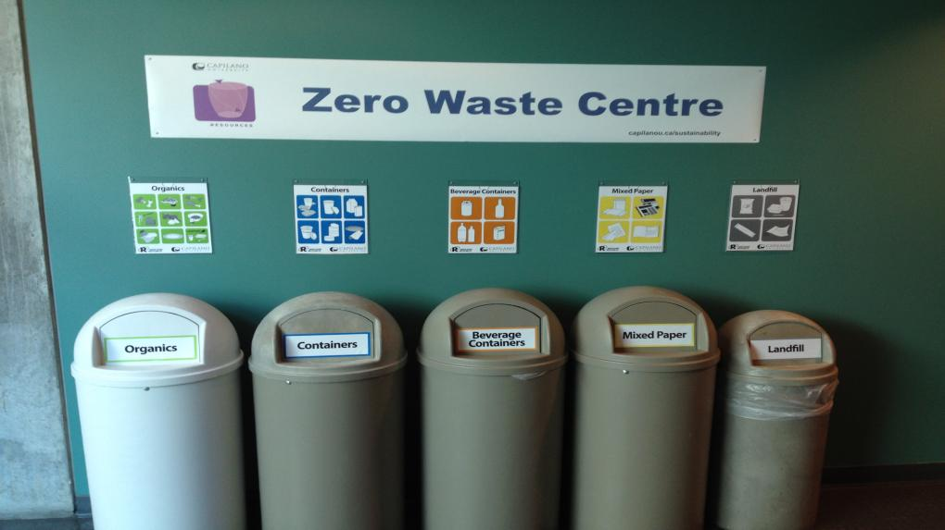
This project try to reuse our waste in a continuous cycle

Slide 27
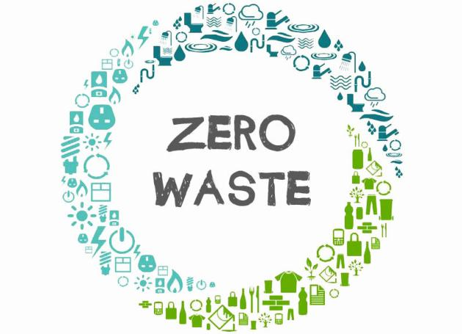
This movement works so that the business and people work together to solve the problem of garbage

Slide 28
Bea Johnson’s the leader of the Zero Waste movement

Slide 29
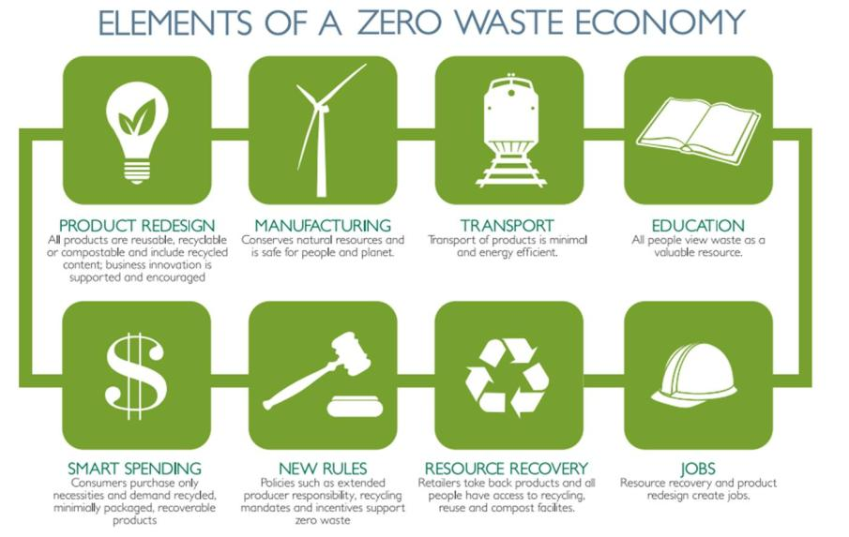

Slide 30
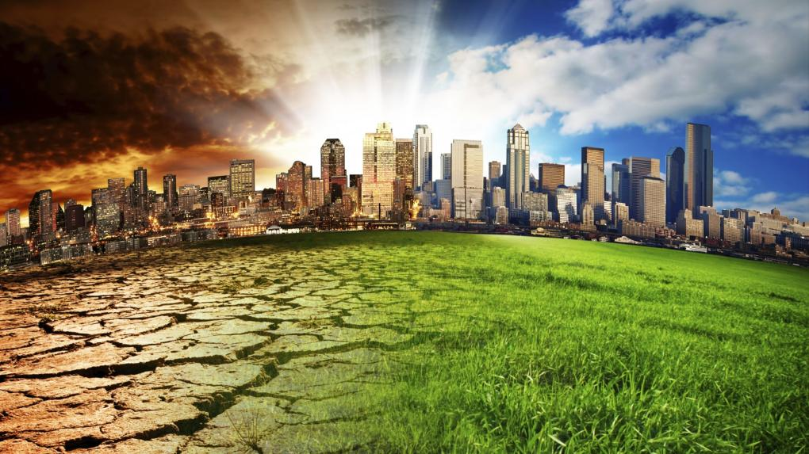
Zero waste is one of the best options to fight against the climate change

Slide 31
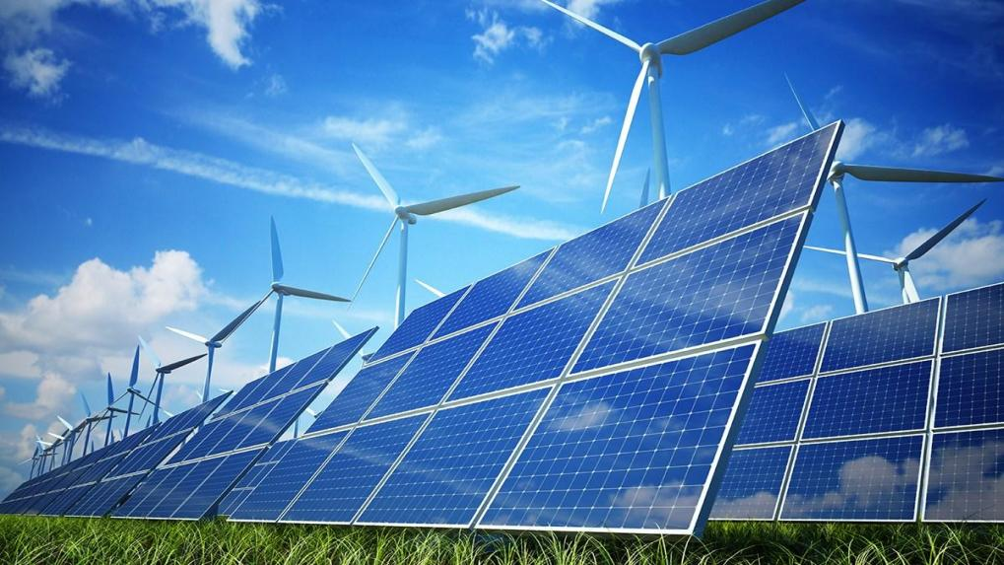
https://www.youtube.com/watch?v=KEeH4EniM3E

Slide 32
